Slide 1

Machine Learning with H2O & Python
Ravi Shankar
UConn

Slide 2
Agenda
About Me
About H2O
H2O Architecture
Machine Learning Algorithms on H2O
Hands-on with H2O in Python
Questions & Answers

Slide 3
About Me
Bachelors from Indian Institute of Technology (IIT) Roorkee
Currently pursuing MS in Business Analytics from UCONN
4 Years of experience in Analytics field
Worked with Python, R, Java
Ravi.2.Shankar@uconn.edu
Linkedin.com/in/ravishankar001

Slide 4
About H2O
Fast, Scalable, Open source application for machine/deep learning
Big names such as PayPal, Nielsen Catalina, Cisco use H2O
Using in-memory compression, H2O handles billions of data rows in-memory even on small cluster
Easy to Use APIs with R, Python, Scala, Java, JSON, and CoffeeScript/JavaScript, as well as a built-in web interface, Flow
H2O is designed to run in standalone mode, on Hadoop, or within a Spark Cluster
http://www.h2o.ai

Slide 5
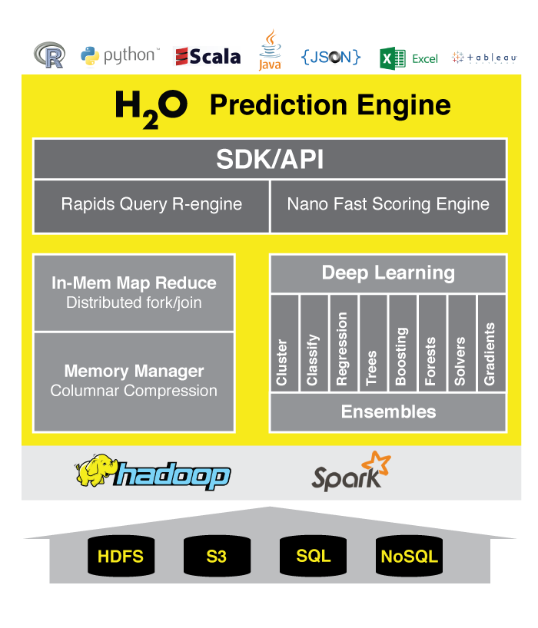
H2O Architecture

Slide 6
Machine Learning Algorithms on H2O
H2O includes many common machine learning algorithms, such as generalized linear modeling (linear regression, logistic regression, etc.), Naive Bayes, principal components analysis, k-means clustering, and others. H2O also implements best-in-class algorithms at scale, such as distributed random forest, gradient boosting, and deep learning.
Sparkling Water
Steam
Deep Water

Slide 7
Hands-on with H2O using Python
Open up IPython Notebook
Go to bit.ly(TBD) link to download the IPython notebook & data
Looking at Marketing data set from UCI web repository (http://archive.ics.uci.edu/ml/)
Classification Problem (http://archive.ics.uci.edu/ml/datasets/Bank+Marketing)
Goal - The classification goal is to predict if the client will subscribe (yes/no) a term deposit (variable y).
Let’s get Started!!

Slide 8
Questions?

